Slide 1
PROJECT TITLE: Ashok's Portfolio: Hardware, Data & Design

Slide 2
NAME OF THE STUDENT: CHITIKIREDDY ASHOK
DEGREE: B.TECH
BRANCH & SECTION: EEE-C
BATCH START DATE: 04-12-2025
BATCH END DATE: 06-12-2025
PROJECT LINK:https://my-site-9wf10tbu-ashokchitikireddy7.wix-vibe.com

Slide 3


Slide 4
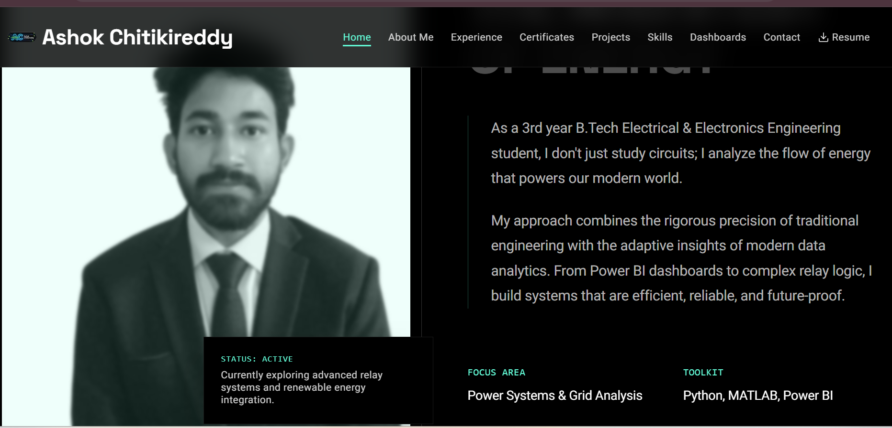

Slide 5


Slide 6
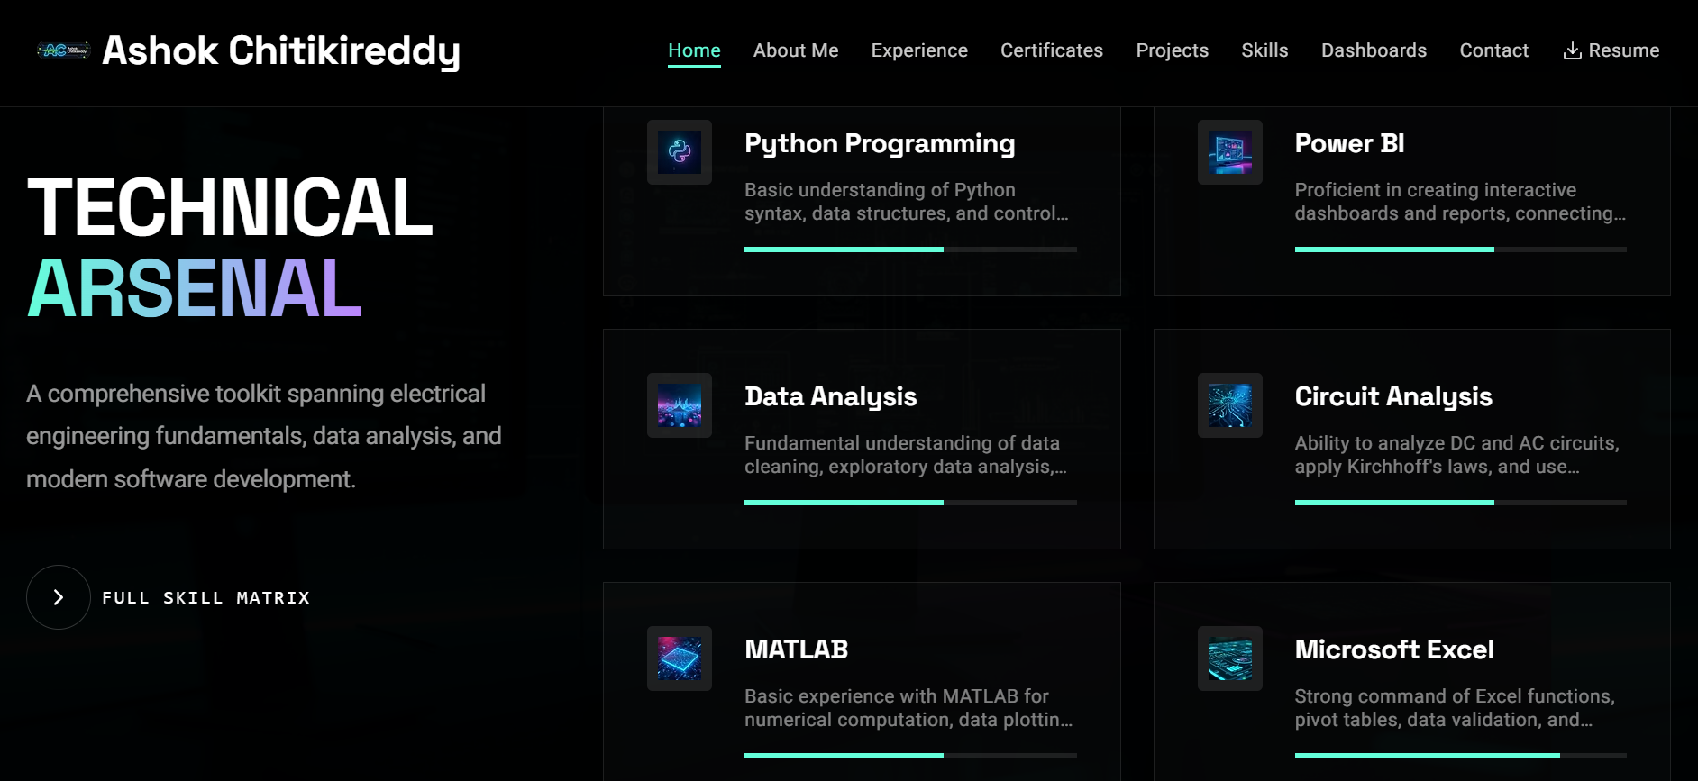

Slide 7


Slide 8
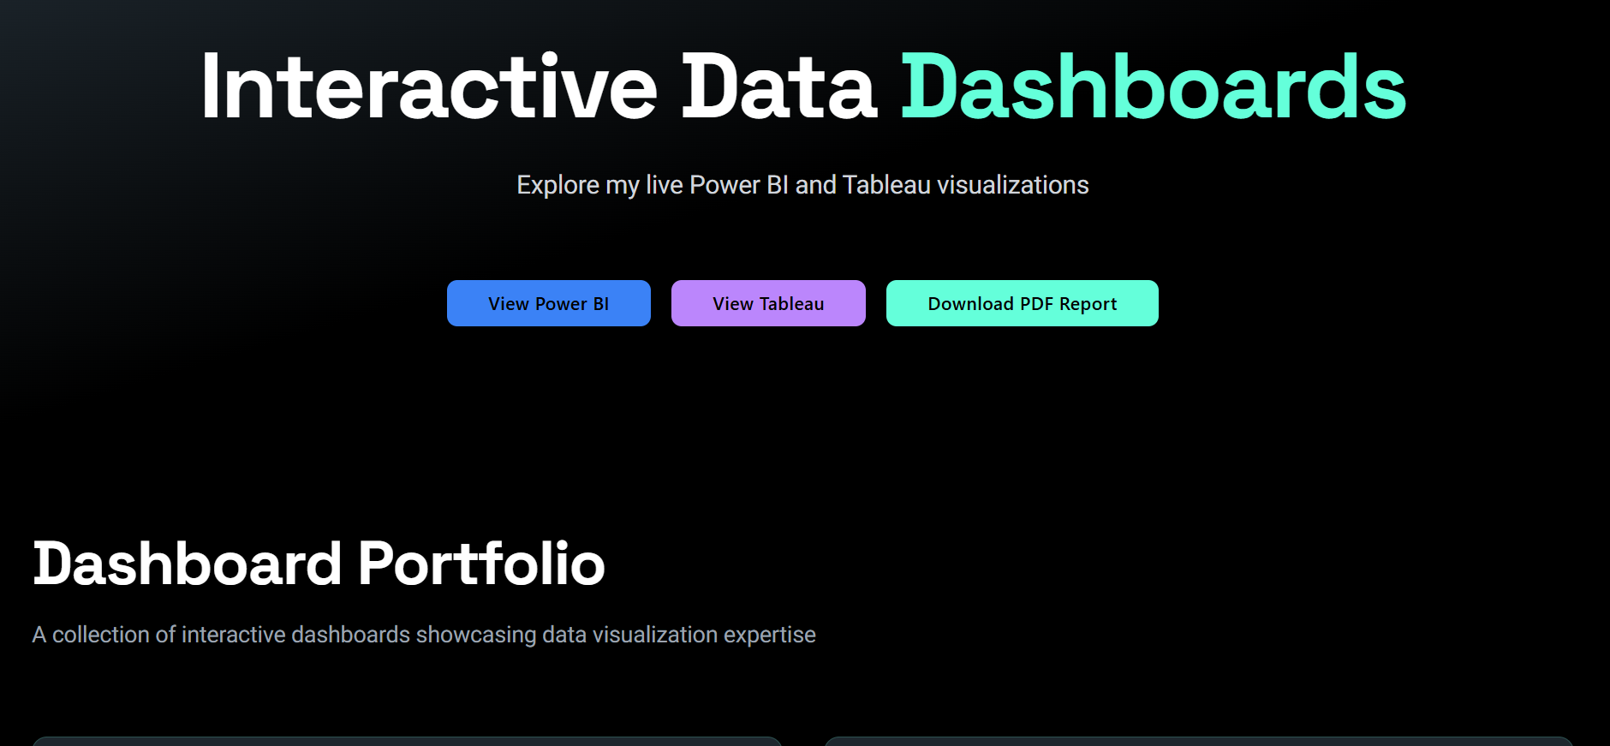

Slide 9
PROJECT DISCRIPTION:
Based on your diverse work (EEE, Data Analytics, and Web Development) and the need for simplicity, here are clean and direct titles for your website.
1. Simple & Direct (Best for Header)
Ashok Chitikireddy (Classic & Professional)
Ashok's Portfolio
Engineering & Analytics
Ashok: Engineer & Analyst
2. Short & Action-Oriented
Building Smart Solutions
Data, Design, Engineering
Precision in Practice
Powered by Logic
3. Modern & Minimal
The Ashok Archive
Circuit & Code
Simply Engineered
Tech & Insights
Recommendation:
For the simplest, most professional look, just use your name Ashok Chitikireddy as the main title and Engineer & Data Analyst as the subtitle.uxfol​
TOOLS USE: WIX.VIBE.AI

